Slide 1
Capstone Project-2
Seoul Bike Sharing Demand Prediction
by- Team Data Avengers Rutuja Ahire Rahul Chavan

Slide 2
Contents
1)Data Summary
2)Problem Statement
3) Exploratory Data Analysis
o Visualizing Rented Bike Count, Hour with Respect to different categorical Feature
o Visualizing Value count of Categorical Features
o Visualizing Distribution of Data
o Normalize Dependent Variable
o Visualizing Regression Plot of Data
7) Correlation Analysis
8) Evaluation Matrix of all the models
9) Model Explainabiltiy
10) Model Validation & Selection
11)Challenges
12)Conclusion

Slide 3
Data Summary
1]Bike sharing has been gaining importance over the last few decades. More and more people are turning to healthier and more live able cities where activities like bike sharing are easily available. There are many benefits from bike sharing, such as environmental benefits. It was a green way to travel.
2] The dataset contains weather information (Temperature, Humidity, Windspeed, Visibility, Dewpoint, Solar radiation, Snowfall, Rainfall), the number of bikes rented per hour and date information.
3] This dataset contains the hourly and daily count of rental bikes between years 2017 and 2018 in Capital bike share system with the corresponding weather and seasonal information. The dataset contains 8760 rows (every hour of each day for 2017 and 2018) and 14 columns (the features which are under consideration).

Slide 4
Problem Statement
Currently Rental bikes are introduced in many urban cities for the enhancement of mobility comfort. It is important to make the rental bike available and accessible to the public at the right time as it lessens the waiting time. Eventually, providing the city with a stable supply of rental bikes becomes a major concern. The crucial part is the prediction of bike count required at each hour for the stable supply of rental bikes.

Slide 5
Exploratory Data Analysis

Slide 6
Rented Bike Count, Hour with Respect to different categorical Feature
Observation: From all these point plot we have observed a lot from every column like:
Season:
In the season column, we are able to understand that the demand is low in the winter season.
Holiday:
In the Holiday column, The demand is low during holidays, but in no holidays the demand is high, it may be because people use bikes to go to their work.
Functioning Day:
In the Functioning Day column, If there is no Functioning Day then there is no demand
Days of week:
In the Days of week column, We can observe from this column that the pattern of weekdays and weekends is different, in the weekend the demand becomes high in the afternoon. While the demand for office timings is high during weekdays, we can further change this column to weekdays and weekends.
Month:
In the month column, We can clearly see that the demand is low in December January & February, It is cold in these months and we have already seen in season column that demand is less in winters.
Year:
The demand was less in 2017 and higher in 2018, it may be because it was new in 2017 and people did not know much about it.

Slide 7
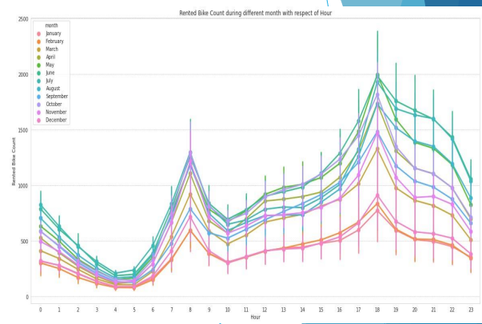

Slide 8
Visualizing value count percentage of each categorial features
HOUR:
Hour is distributed equally.
SEASON:
Season is also equally distributed.
HOLIDAY:
No holiday comes 95% and holiday 5%
FUNCTIONING DAY:
Yes comes 97% and No comes 3%
MONTH:
Month is also equally distributed.
YEAR: 2018 comes 92% and 2017 comes 8%.We think may be n 2017 they are new

Slide 9
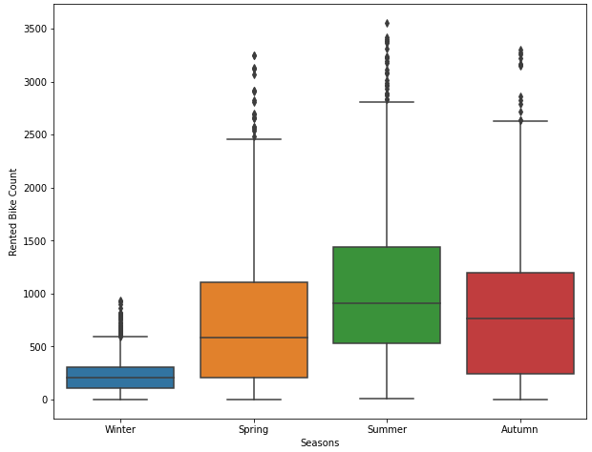
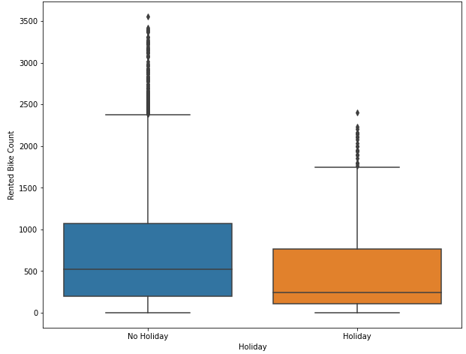
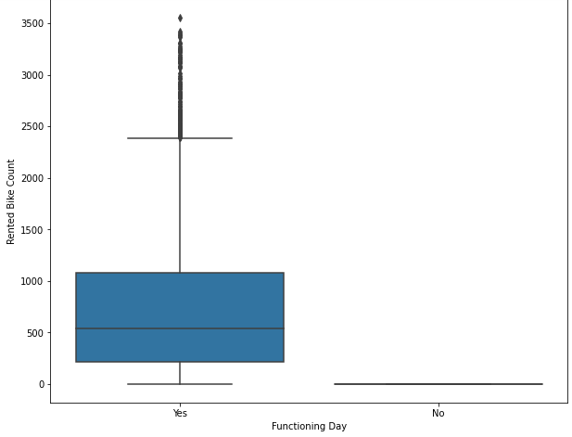
1)Less demand on winter season.
2)Slightly higher demand NON holidays.
3)Almost no demand on NON functioning day.

Slide 10
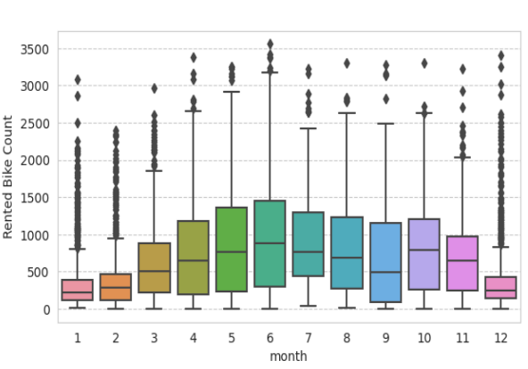
1)We can see that there is less demand of Rented bike in the month of December, January, February i.e., during winter seasons.
2)Also demand of bike is maximum during May, June , July i.e., summer seasons

Slide 11
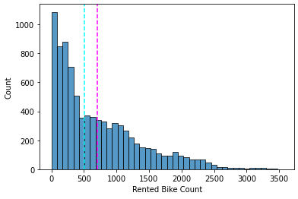
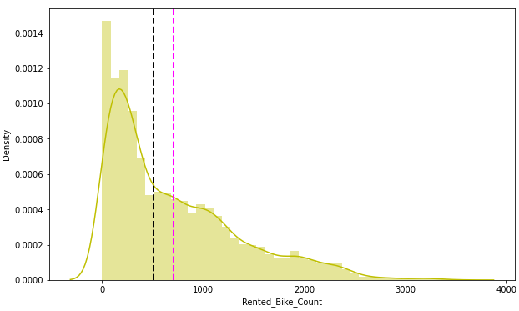
Distribution of Numerical Features
Right Skewed Columns are:
Rented Bike Count (its also our dependent variable), Wind Speed(m/s), Solar Radiation (MJ/m2), Rainfall(mm), Snowfall(cm).
Left skewed columns are:
Visibility (10m), Dew point temperature(c)

Slide 12
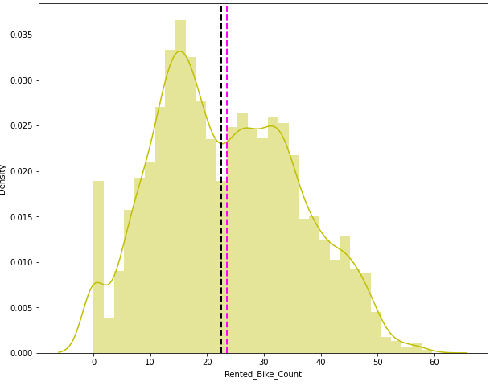
Normalize Dependent Variable for Linear Models
Before transformation: our dependent variable is right skewed.
After transformation: our dependent variable in green plot is normalized to some extent: so we will go with square root on our dependent variable.

Slide 13
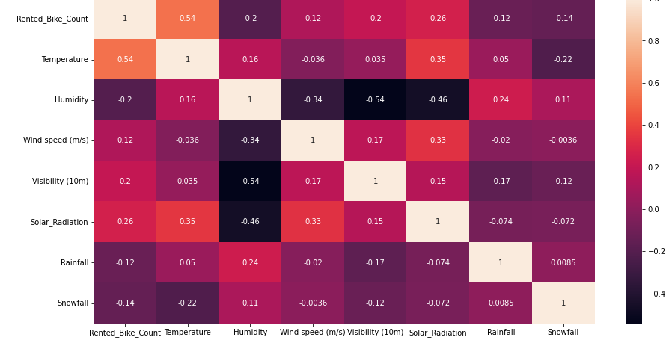
Correlation Analysis
From the correlation graph with heat map we saw that dew point temp and temperature is highly correlated. Then we checked VIF and concluded that these two features are affecting VIF score also.so we decided to drop one of these features and to do this we checked which feature is least correlated with Dependent Variable and we identified it to be Dew point temperature and therefore we drop the dew point temperature.

Slide 14
Models Performed

Slide 15
List of Models
⮮ Linear Regression with regularizations (Lasso & Ridge)
⮮ Polynomial Regression
⮮ Decision tree
⮮ Random Forest
⮮ Gradient Boosting Regressor
⮮ Extreme Gradient Boosting
⮮ KNN Regression
⮮ LightGBM
⮮ CatBoost

Slide 16
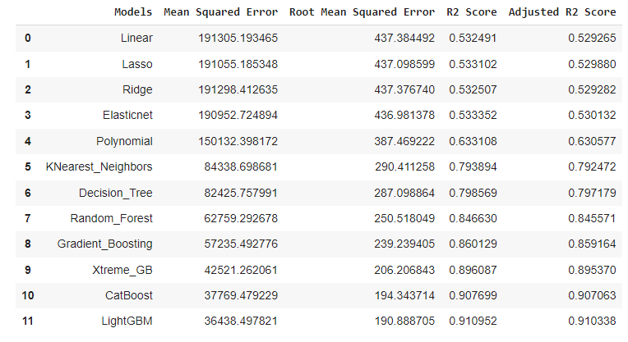
All Models Evaluation without Hyperparameter turning
The Best model is Linear Regression but it is over fitted, that’s why We are using Hyperparameter tuning so that we can reduce the overfitting and increase the accuracy.

Slide 17
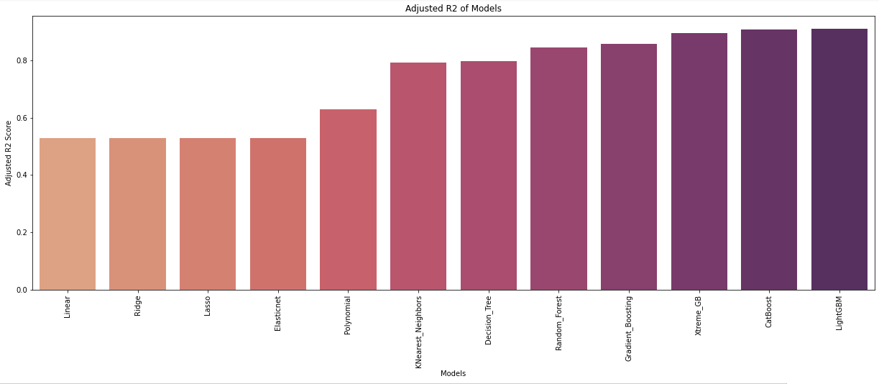
Adjusted R2 score with respect to models without applying hyper parameter tuning

Slide 18
All Models Evaluation with hyperparameter tuning
Top 3 best performing models are :
1. Linear Regression
2. Lasso & Ridge Regression
3. Polynomial Regression

Slide 19
Adjusted R2 score with respect to models after applying hyper parameter tuning

Slide 20
MODEL EXPLANABILITY

Slide 21
Linear Regression & Lasso Regression
Linear regression analysis is used to predict the value of a variable based on the value of another variable. The variable you want to predict is called the dependent variable. The variable you are using to predict the other variable's value is called the independent variable.
Lasso regression is a type of linear regression that uses shrinkage. Shrinkage is where data values are shrunk towards a central point, like the mean. The lasso procedure encourages simple, sparse models (i.e. models with fewer parameters).

Slide 22
Ridge Regression & Random Forest
Ridge regression is a method of estimating the coefficients of multiple-regression models in scenarios where linearly independent variables are highly correlated. It has been used in many fields including econometrics, chemistry, and engineering.
Random Forest Regression is a supervised learning algorithm that uses ensemble learning method for regression. Ensemble learning method is a technique that combines predictions from multiple machine learning algorithms to make a more accurate prediction than a single model.

Slide 23
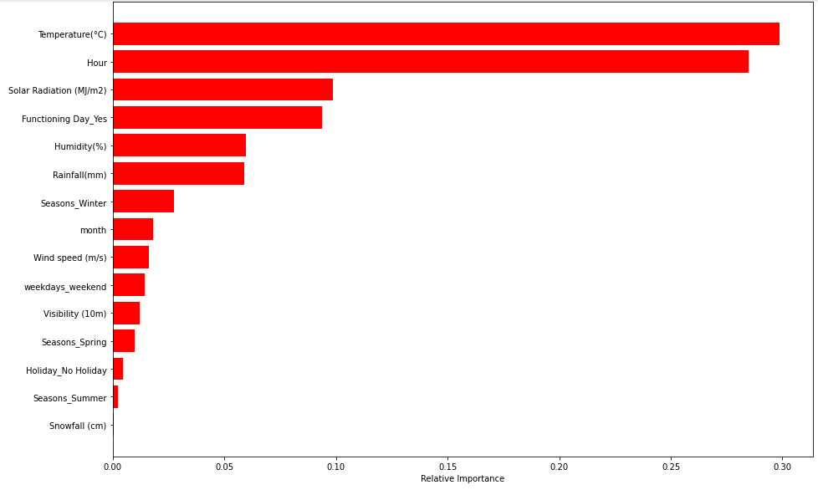
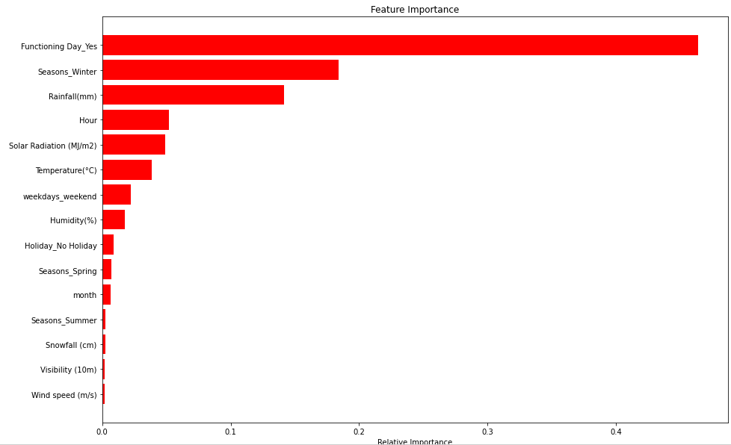
Explaining Gradient Boosting & Extreme Gradient

Slide 24
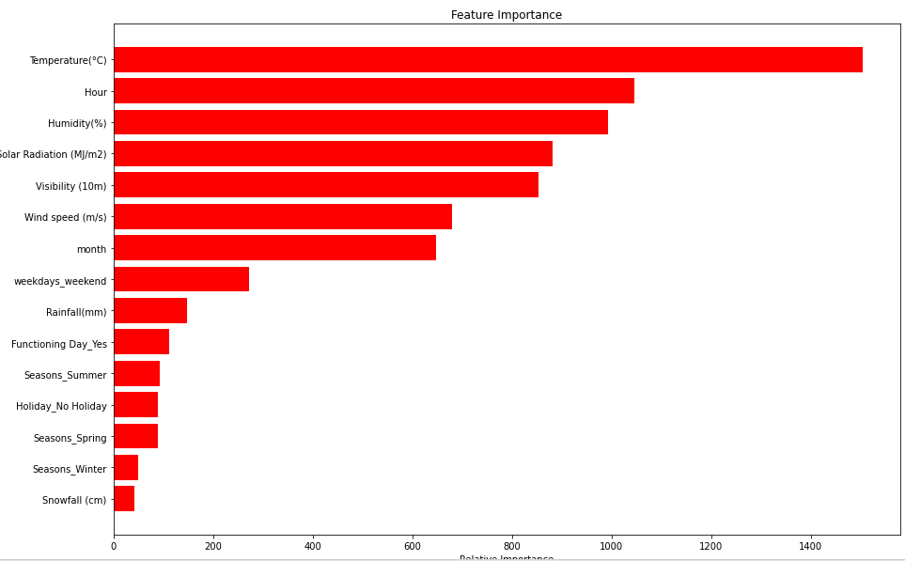
LightBGM
LightGBM is a gradient boosting framework based on decision trees to increases the efficiency of the model and reduces memory usage.

Slide 25
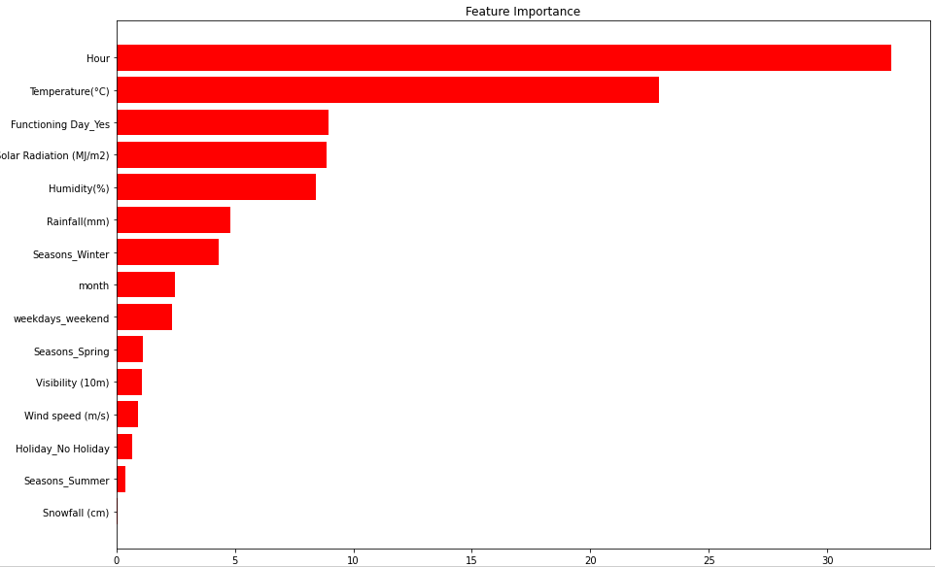
CatBoost
CATBOOST is an open-source machine learning library developed by a Russian search engine giant Yandex. One of the prominent aspects of catboost is its ability to handle missing data and categorical data without encoding but will get to that later. It makes feature engineering tasks easier and in some cases extinct.

Slide 26
Model Validation & Selection
● Observation 1: As seen in the Model Evaluation Matrices table, Linear Regression is not giving great a results.
● Observation 2: Gradient Boosting, Xtreme Gradient Boosting and Random Forest have performed equally good in terms of adjusted r2.
● Observation 3: We are getting the best results from CATBOOST and LIGHTBGM.

Slide 27

Challenges
● A huge amount of data needed to be deal while project which is doing the quite an important task and also even small inferences need to be kept in mind.
● As dataset was quite big enough which led more computation time.

Slide 28

Conclusion
1. In holiday or non-working days there is demands in rented bikes.
2. There is higher rented bike demand from 8am to 9pm.
3. The demand rises most at 8am and 6pm which are the prime office opening and closing times.
4. People prefered more rented bikes in the morning than the evening.
5. The Temperature, Hour & Humidity are the most important features that positively drive the total rented bikes count.
6. We can use either lightGBM or catboost model for the bike rental stations as these models show a higher value for adjusted R2 score.

Slide 29
Thankyou

